Slide 1
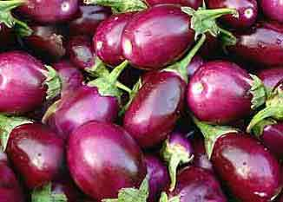
“Seeds of Discord”
Bt Brinjal Sovereignty movement in India
Somava Pande

Slide 2
Outline
Purpose of the project
Intellectual property rights
IP laws in India
Relation between IP rights and sovereignty
Making of scales
Various conceptions of sovereignty
Vernacular discourses
Research Questions
Methodology

Slide 3
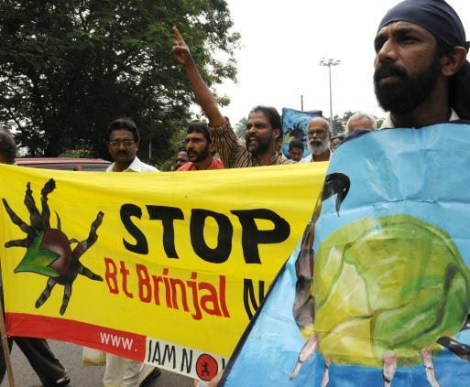
Purpose
To understand social activism by theorizing that varied conceptions of sovereignty make claims within social movements like Brinjal seed sovereignty movement in India.

Slide 4
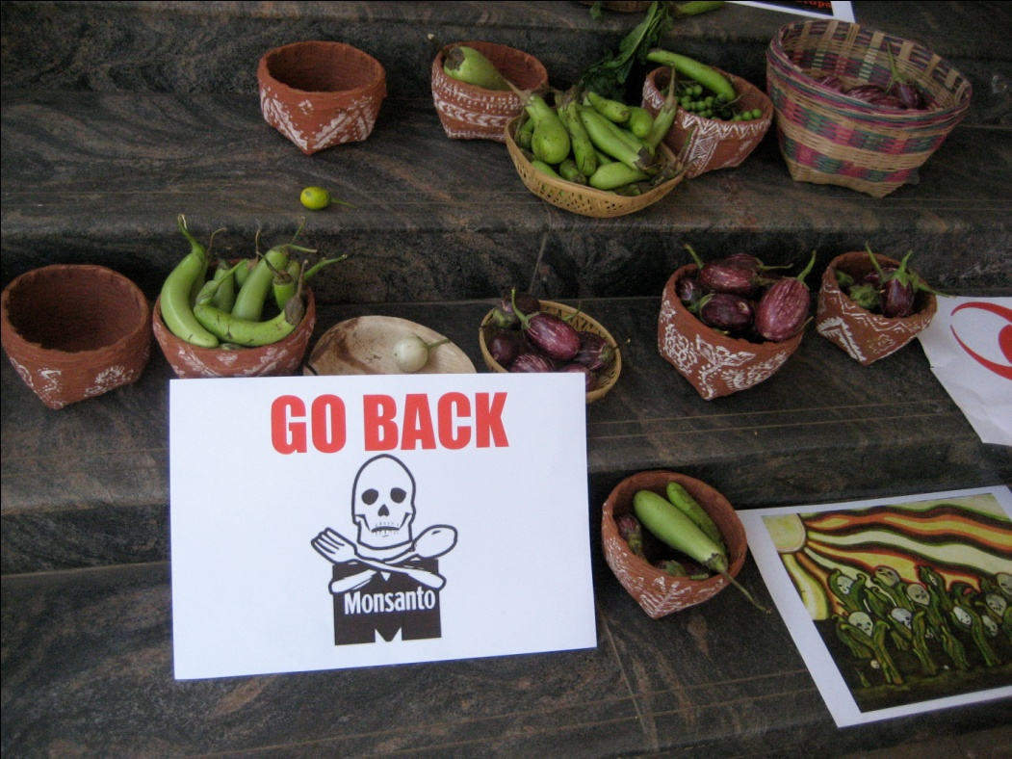
Bt Brinjal Seed sovereignty movement
Bt Brinjal Seed sovereignty movement was initiated in July 2009 (Natarajan, 2009 July)
Movement against Seed Laws and Patent Laws (“navdanya,” n.d).
Seed laws make sharing and saving of seed a crime
The movement demands that Indian laws should not legalize patents on seed
Review Trade-Related Aspects of Intellectual Property's in order to exclude patents on seed and food ("navdanya," n.d.).
The movement pledged to protect sovereignty to save native seeds (“greenpeace,” 2009 July)
Notes:
as part of the Seed sovereignty movement
followed Mahatma Gandhi's inspiration from the Salt Satyagraha, Gandhi's non- violent protest against the British salt monopoly in colonial India, Navdanya declared the launch of "Beej Satyagraha"
by making seed the "property" of companies like Monsanto, and forcing indigenous farmers to pay royalties for what was their (India's) collective heritage.

Slide 5
Intellectual property rights
Patents and the rhetoric of “ownership society” seeks to own, control, monopolize everything (water, cells, genes, animals, plants) in which life has no intrinsic worth, integrity or subject hood.
IP rights are fed by the conceit of romantic authorship.
“The author vision blinds us to the importance of the commons—to the importance of the raw material from which information products are constructed” (Boyle, 1996, p. xiv).

Slide 6
IP laws in India
Agreement on Trade Related Aspects of Intellectual Property Rights (TRIPS)
Geographical Indication Act (GI Act)
Notes:
To establish a property regime, TRIPS requires substantial standards of protection for intellectual property in all member states. To enable foreign ownership, TRIPS imposes national treatment obligations, requiring states to treat foreigners as equals of their own citizens. This cocktail of robust private property rights and foreign access thereto is leading to a steady transfer of the “ownership” of intellectual “products” from the developing world to the developed World (Chander & Sunder, 2004)
Required by TRIPs5 originally as a means to protect French makers of wines and champagnes, the law gives trademark-like protection to distinctive goods or services whose quality and reputation derive from the geographical area in which they are produced After a decade long resistance to intellectual property laws, many in India began to question how these laws could be beneficial to them. This lead to an increase in appeals for GI (Geographical Indication Act of 1999) of goods, which was seen as a source of recognition and income for India's poor rural as protection will allow local artisans to stay in their communities and fend for themselves, without having to renounce their traditional work. As Sunder (2007) pointed out even though GIs certainly hold promise for the poor, they have limits as it protects only those goods or processes whose quality or reputation are shown to be "due exclusively or essentially to the geographical environment, with its inherent natural and human factors" (p. 114).

Slide 7
Relation between IP rights and sovereignty
The notion of sovereignty is integrated with the idea of romantic author, which is at the core of IP rights
IP rights assign rights to certain parties to control information, which provides them sovereignty, while foreclosing certain other uses by taking away power from others (Boyle, 1996)
Coombe asserts that sovereignty the IP holders achieve, can work as a powerful force in claims to own images of alterity (Coombe, 1998)
Boyle points at the importance of public domain in understanding the “other side” of intellectual property
Notes:
Information society is characterized by conflicting valences between private and public domain. Boyle’s focus on public domain helped to foster “the invention of traditional knowledge” as a political and legal category worthy of rights. (Chander & Sunder, 2004)

Slide 8
Making of scales
Tsing (2005) explains scale making may be “projects that make us imagine globality in order to see how it might succeed….or projects that make us imagine locality, or the space of regions or nations, in order to see their success” (p. 57).
Distinct scale making at the level of
Nation state
Ecological group “Navdanya”
Farmers
Notes:
TRIPs protected the knowledge and economic interests of the developed world, the rich corporations of the West. Can intellectual property be a tool for
protecting poor people’s knowledge as well? Many seem to think so. Sunder (2007) mentioned the case of an award-winning farmer in Kerala who developed a high-yield method for planting rubber trees, but later when somebody tried to plant (rubber tree) in the same way, the farmer objected and stated that he would get a patent in this. Sunder (2007) noted an apparent shift in appropriating intellectual property in India, as the farmer who had only elementary school education had some idea about this particular law where you can stop somebody else from using his conceptualized method.

Slide 9
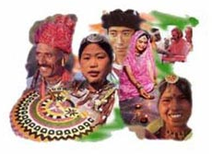
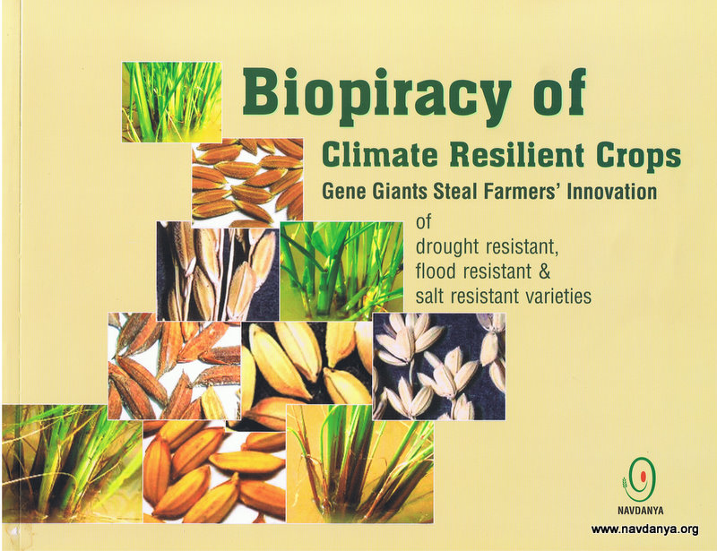
Various conceptions of sovereignty
National conception
Unity in diversity
Ecological group conception
save native seeds and grow food freely without MNCs domination and control
Notes:
which attempts to imagine an Indian nation that embodies cultural pluralism, overlooking caste, race religion, or linguistic differences that make up the composite whole, the elision of the categories of caste and race from the national discourse silenced any oppression based on these constructs
Hence, the dominant group, stressed on "unity" through the logics of homogenized diversity. This excluded the subordinate groups defined by class differences and helped in the consolidation of hegemony in Indian political scenario.

Slide 10
Continued
Tsing (2005) argues that a movement is constantly reconstituted or redefined through the “other”
Exclusion of the internal "Other" becomes a privileged site for locating internal resistance of the marginalized group
Notes:
West (2012) demonstrated that Gimi peoples, who grow coffee in Papua New Guinea's highlands are misrepresented in the specialty coffee market, which relies on images of primitivity and poverty to sell coffee.
Similarly, Deloria (2004) demonstrated that since Indians who were presumed to be in reservations, were assumed to have little or no contributions towards "modernity," and these expectations helped reinforce the image of natives as primitive people.
As Sunder (2007) noted that cultural rights often lead to the ironic production of authenticity or indigeneity, which conforms to traditional structures from the past, rather than celebrating cultures as diachronic peoples who are dynamic and heterogeneous.

Slide 11
Vernacular discourse
Helps to understand how discourses work within and reinforce dominant logics (Mirzoeff, 2011)
Highlights how new political agents are formed in the contestation between the nation (authority) and the vernacular that strive against dependence
Will aid in understanding if there are varied forms of sovereignty conceived by the indigenous people that are making claims in the movement
Notes:
Chakraborty (1994) explained that Indian histories have been conceived through the process of translation, which resulted in the emergence of analytical
of what makes common sense and how they challenge those logics
history where through abstraction of capital everything is made exchangeable with one another. Through his conception of History 2, Chakraborty (1994) beckoned scholars to understand more affective narratives of life forms, which are porous but not exchangeable through an abstract term of equivalence.

Slide 12
Research Questions
How do indigenous farmers (Brinjal growers) define sovereignty?
How do farmers reconstruct the dominant discourse of Beej Swaraj (seed sovereignty) by interpreting it through their own ideologies?
What are the local understandings of intellectual property? How are they conceived and circulated within the community? How do farmers construct and establish their own agency as they conceive intellectual property?
How farmers conceive and establish divergent means and meanings of the cause of the seed sovereignty movement based on their specific locales? Do they serve different purposes to local communities and other interested parties?
How are divergent understandings of different things (sovereignty, intellectual property etc) used within the local, social, and cultural system? How are they circulated, and remixed within the communities, individually, and collectively?

Slide 13
Methodology
Sample areas- State of West Bengal and Karnataka focusing on regions that have a significant number of brinjal growers.
Qualitative in- depth one- on- one interview with local farmers
Focus group discussion with community members from the two different rural communities in India.
Discourse analysis of news published regarding the activism in those two selected areas
Local news
National news
Notes:
I selected these two areas not only because these two states have the maximum number of Beej Swaraj activist groups (Natarajan, 2013), but also because of their difference in terms of language, geographic locales, and ideologies.

Slide 14
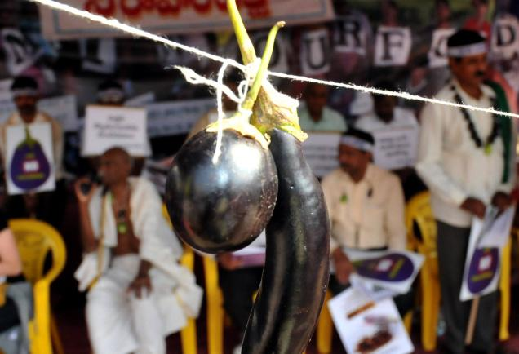
Thank You

