Slide 1
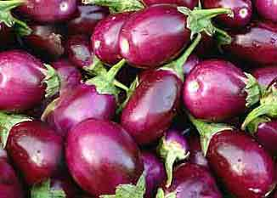
Purpose and RQ
Seed sovereignty movement (Beej Swaraj)
Brinjal Seeds
Bt Brinjal Row in India
Notes:
How do activists use globally circulating political rhetorics to devise and manage coalitions? How do logics of classification order differences among coalition partners even as they make it possible for them to work together? At the same time, how do encounters across difference exceed their disciplined boundaries to make new forms of politics possible?

Slide 2
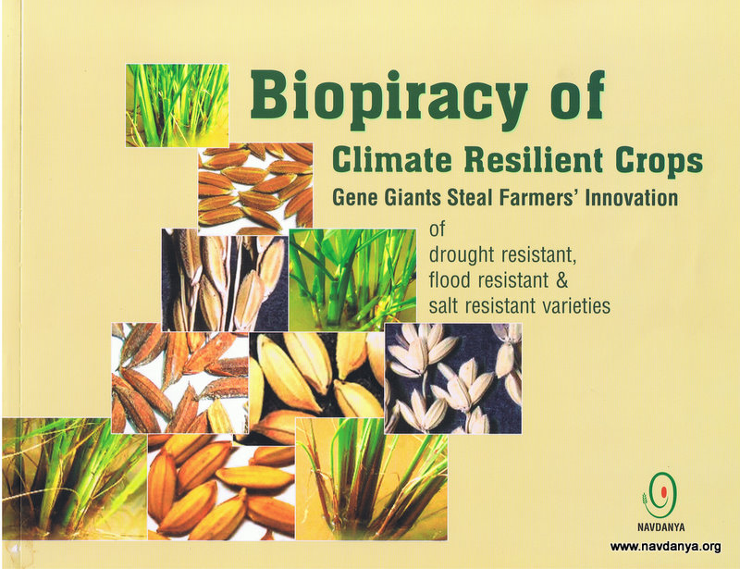
Background and methodology
India opens up its seed sector
Movements against biopiracy
Method
Discourse analysis of campaign blogs, online reports of activists, community newspapers, national newspapers
Notes:
Farm saved seeds were replaced by corporate seeds. A free resource available on farms became a commodity. In 1993 half a million Indian peasants pledge to resist classification of seeds as private property. Victorious struggle for neem, basmati rice and Indian wheat reclaimed collective biology and intellectual heritage as commons.
Neem tree activism (movement mobilized and built at the local levels) and its success laid the path for other activism like basmati rice, Indian wheat.
Neem victory brought to the forefront that most patents are based on the appropriation of indigenous knowledge, which violates the basic criteria of patent (novelty, nonobviousness, utility) as they range from direct piracy to minor tinkering involving steps obvious to anyone trained in the techniques and disciplines involved.
I plan to do discourse analysis of news published regarding the counter power revolution. Community newspapers example Deccan Herald, Ganasakti. I will look at three mainstream English language national newspapers in India: The Times of India, The Hindu, and The Indian Express from August 2009 to July 2012. I am choosing this time frame as during this time another controversy regarding Monsanto's illegally use of Indian brinjal seeds to create GM seeds came into prominence, that triggered country wide uprising, that initiated the judicial system to reconsider the patent law.

Slide 3
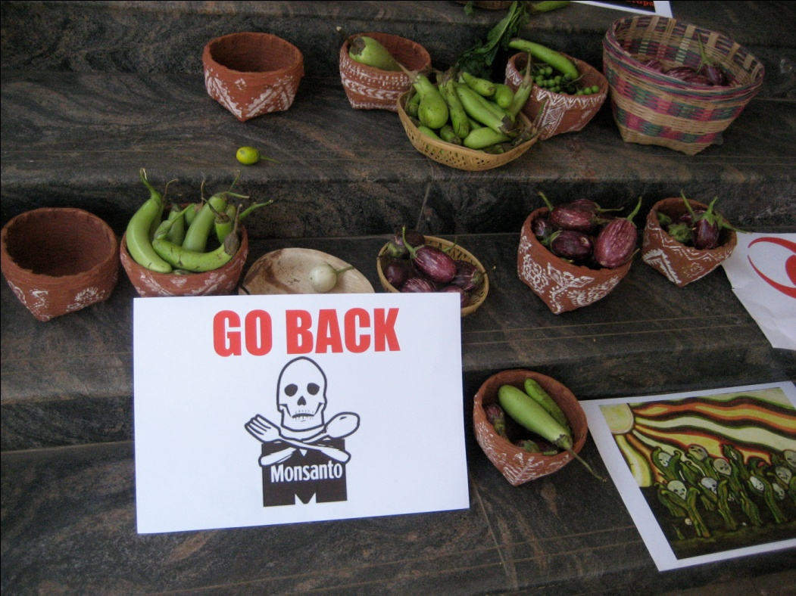
Arguments
Instead of a homogenized notion of social movements reframing of scales is necessary to understand how difference is a pre- established frame for connection
Notes:
to chart how individual actors form and attain agency, how images are formed and what ideologies are embedded in those images. ideas are formulated, how ideas are mobilized to bring about consciousness.

